Slide 1
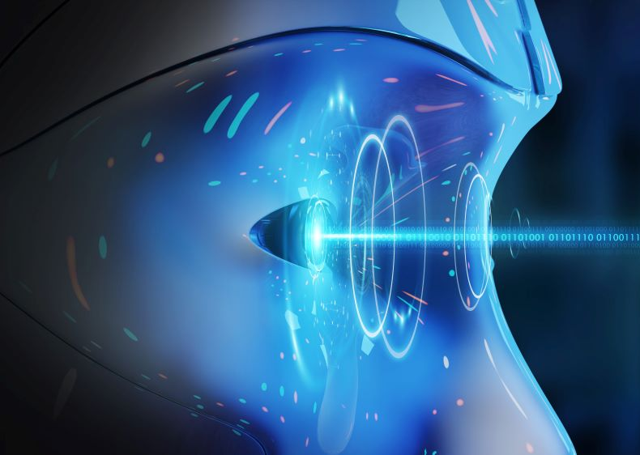
COMPUTER VISION 3D
PROJECT
PROPOSAL
MICHAL HASS
NOAM CASPI

Slide 2
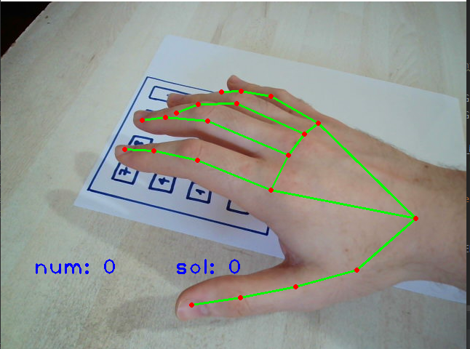
ABOUT THE PROJECT
Our project aim is to build a calculator based on computer vision.
We used the material that was taught in class, such as finding homography between two images.
In addition we used the python OpenCV library

Slide 3
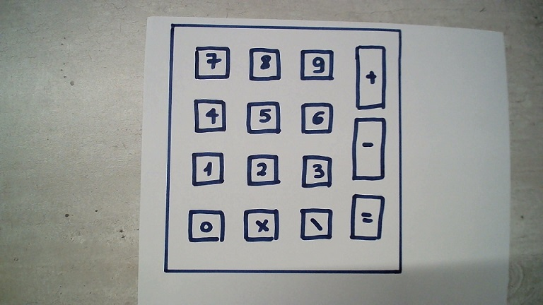
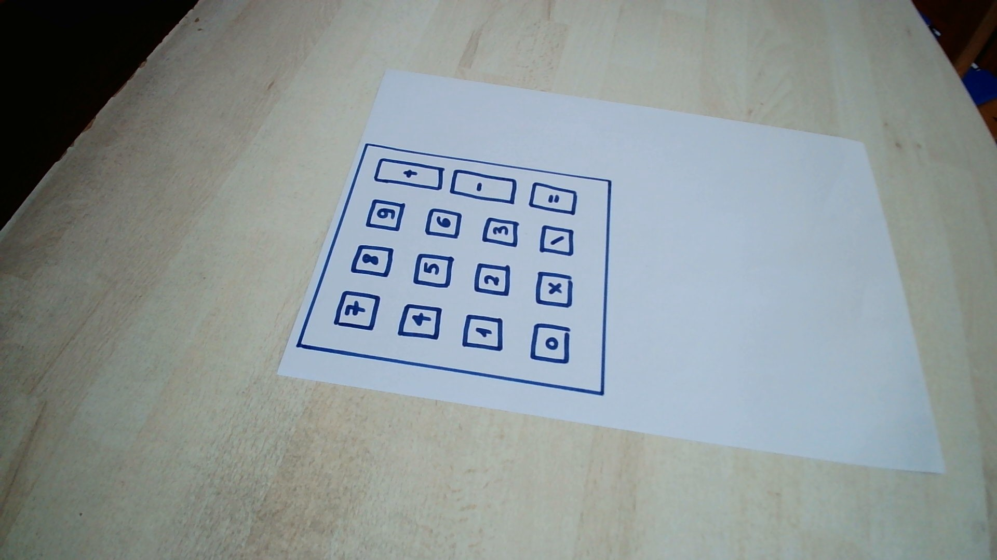
$50,000,000
Reference Image which we took in advance
2,000
Image that the camera captured In real time
75
COMPUTING HOMOGRAPHY

Slide 4
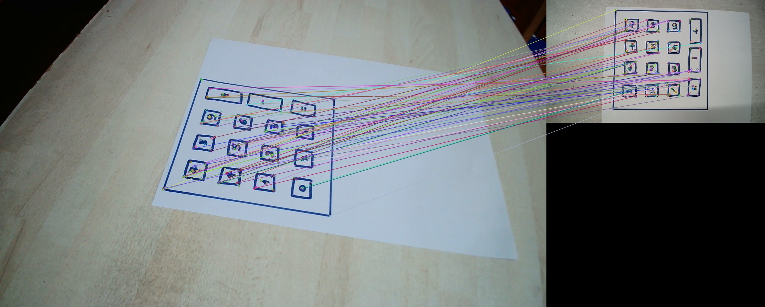
COMPUTING HOMOGRAPHY
We use ORB (Oriented FAST and rotated BRIEF - alternative for SIFT) in order to detect features and compute descriptors.
Then we compute the homography using RANSAC algorithm that we studied in previous courses.

Slide 5
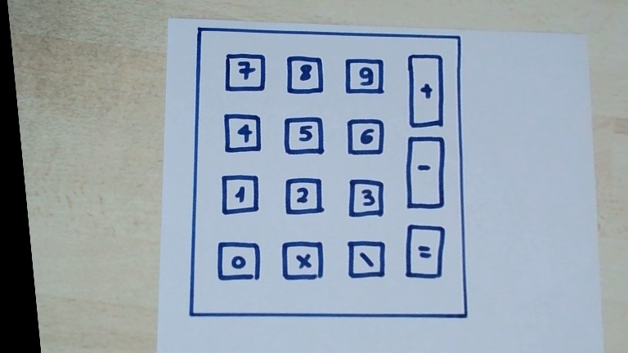
COMPUTING HOMOGRAPHY
The result

Slide 6

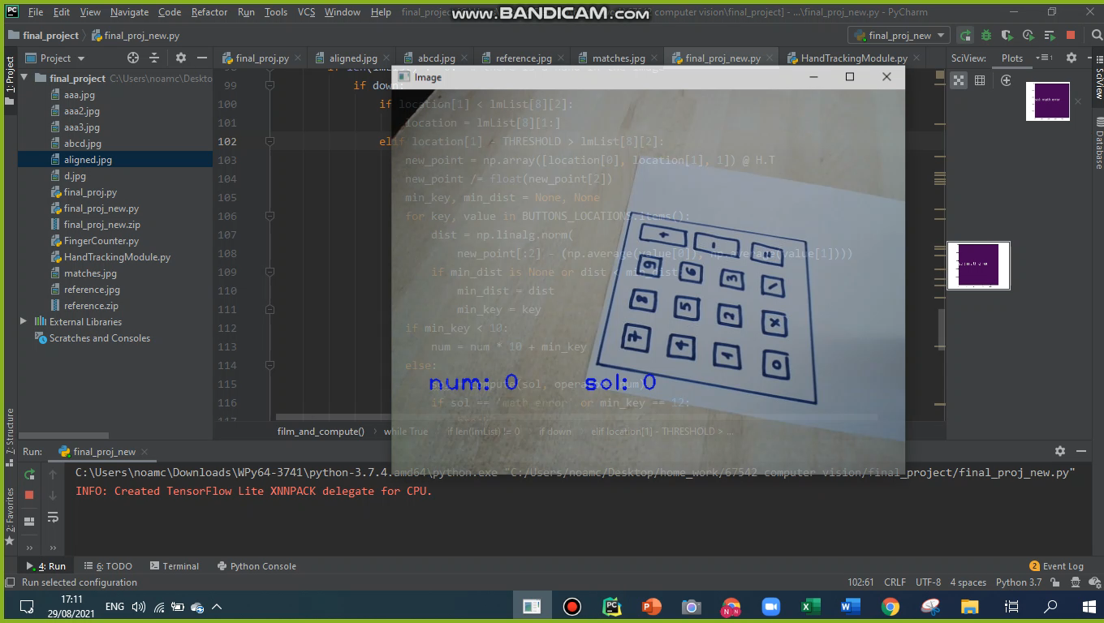
PRESSING DETECTION
To detect a press, we needed to realize when the finger stops going down and starts going up. Hence, we kept an indicator representing whether the finger goes up or down, and in order to switch between the modes, we tracked the finger’s location.

Slide 7
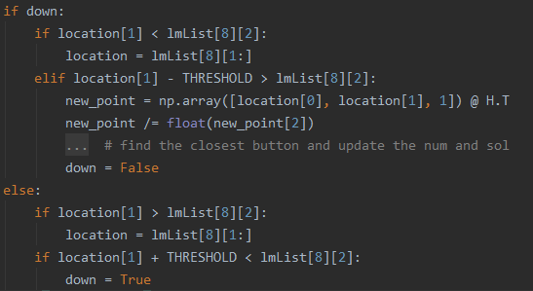

The finger is lower than the saved location
The finger is significantly higher than the saved location → there was a press
PRESSING DETECTION
The finger is higher than the saved location
The finger is significantly lower than the saved location → the case is down

Slide 8

RUNNING EXAMPLE

Slide 9
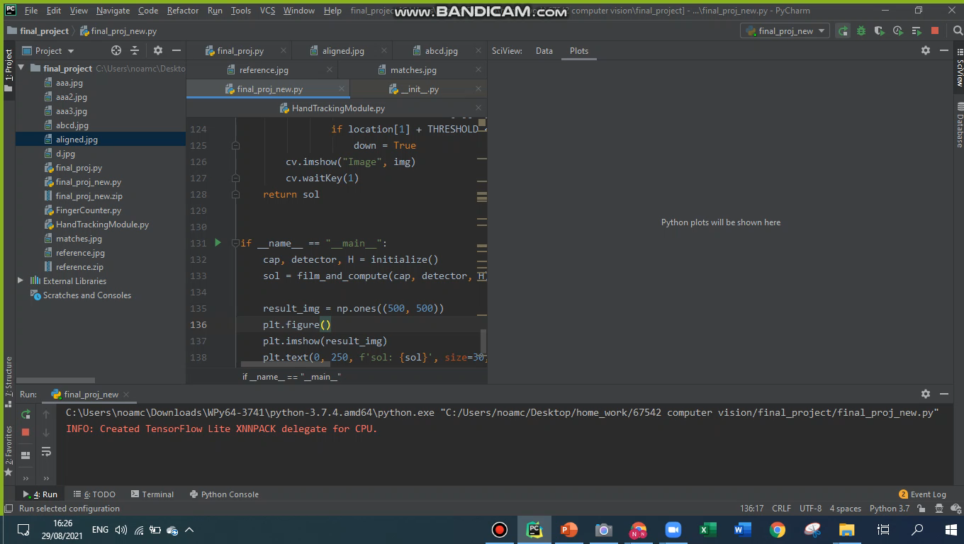
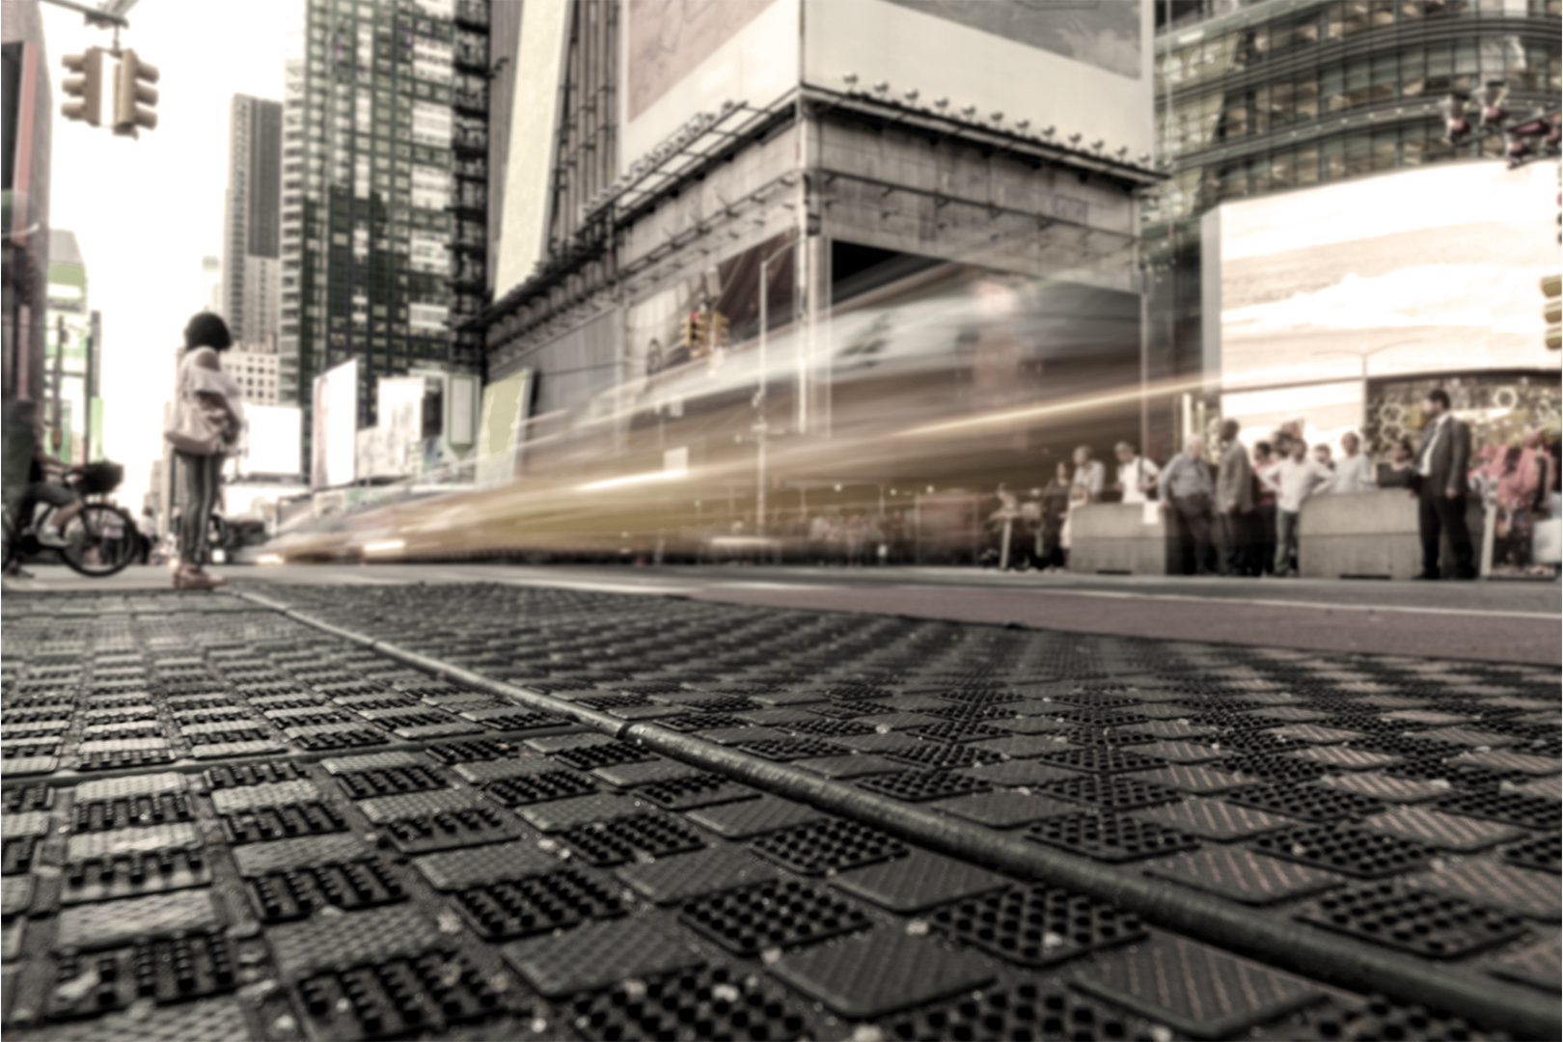
RUNNING EXAMPLE

Slide 10
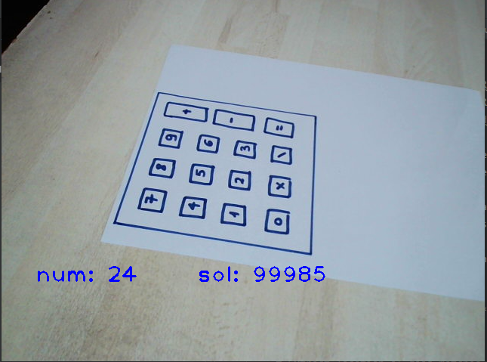
NOTES DETECTION
SMART KEYBOARD
HACKING
EXTENSIONS
We can use the same logic in order to realize which notes were played on a piano (for example)
We can use the same logic in order to realize which buttons were clicked on a keyboard
We can use the same logic in order to reveal passwords of people using only a camera and a small memory device

Slide 11
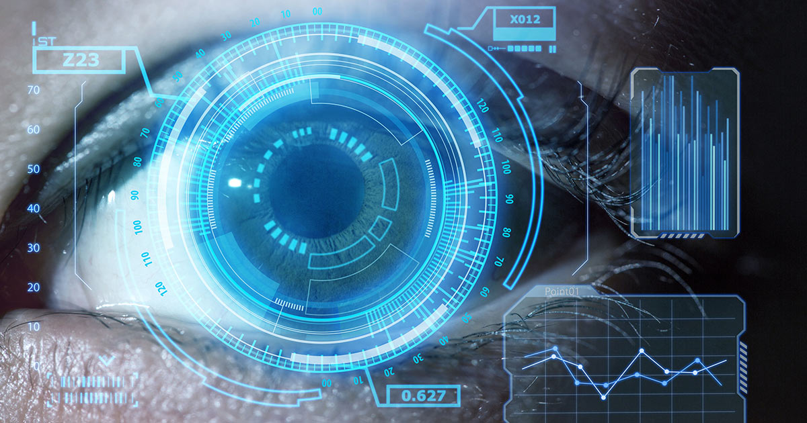
Using programming logic in order to detect real time events.
WHAT WE HAVE LEARNED
Using Computer Vision principles for solving problems.
Creativity, Team-work, Ability to take a big project and break it into sub-tasks.

Slide 12

THANKS
Submitters:
Michal Hass
Noam Caspi

